Slide 1
AF and AF related stroke landscape tool
Using publically available real world data to inform resourcing decisions
Andrzei Orlowski - Associate Director for Health and Implementation

Slide 2
Greater Manchester Academic health science network
Greater Manchester AHSN is a collaborative network bringing together 30 NHS providers and commissioners across Greater Manchester, East Lancashire Trust and East Cheshire and four universities.
Our ambition is to deliver a step change in health outcomes and to support Greater Manchester's strategy for growth through enabling £1bn of wealth creation over five years, supporting SMEs and helping to create a healthier population.

Slide 3
Atrial Fibrillation & AF related stroke health and implementation programme
Our Goal is to help prevent at least 365 avoidable AF related strokes each year
AF implementation programme is encouraging our members to prioritise AF and the adoption of NICE guideline CG180 (The Management of Atrial Fibrillation).
Notes:
Our goal around the appropriate adoption of new technologies
Lucky as AF is hot topic (driven in part by NOACs and the costs associated with them)

Slide 4
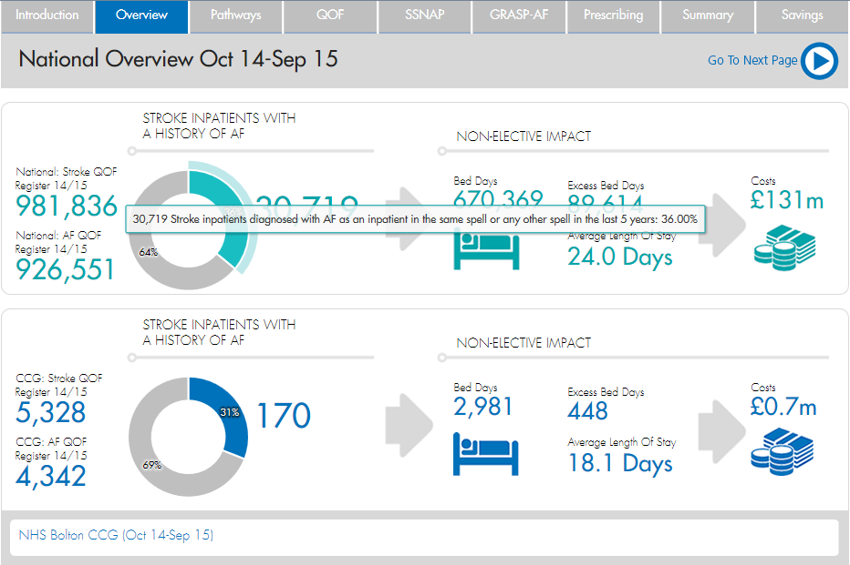
Hospital Episode Statistics

Slide 5
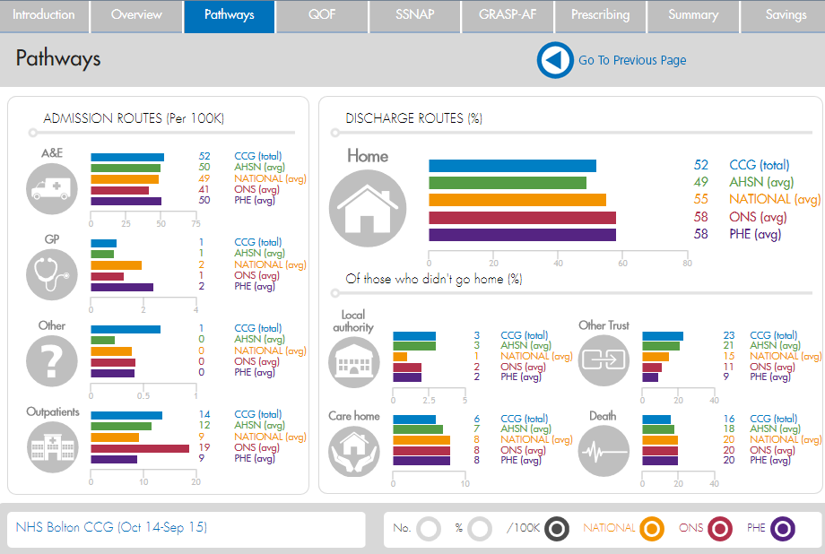
Hospital Episode Statistics

Slide 6
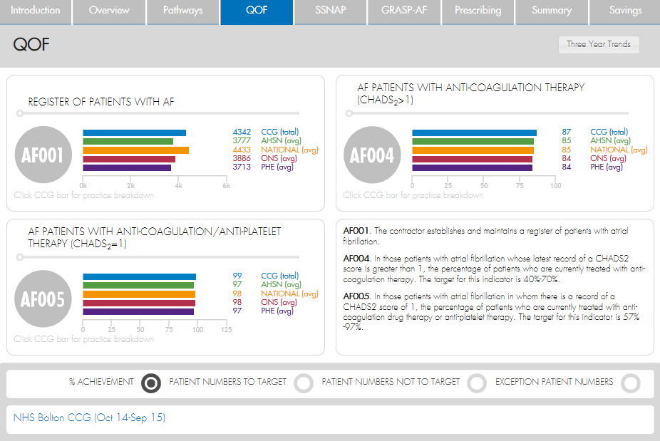
Quality outcomes framework

Slide 7
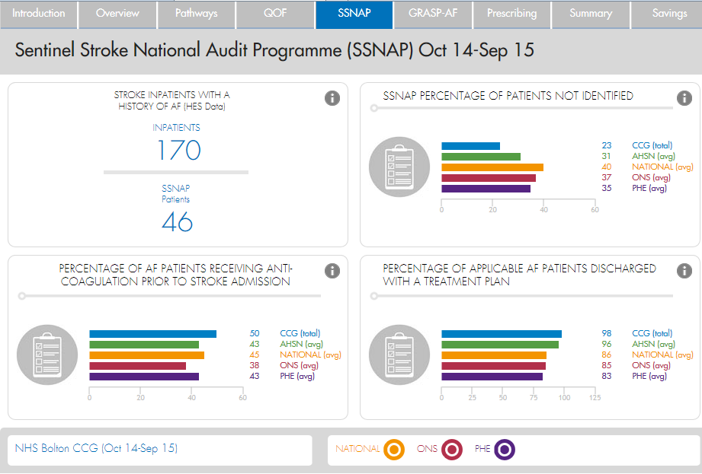
Sentinel stroke national audit programme

Slide 8
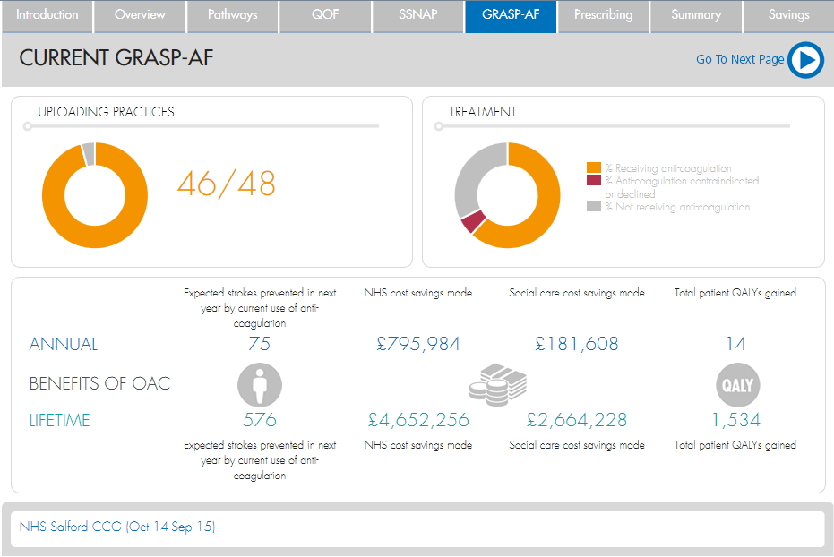
GRASP-AF

Slide 9
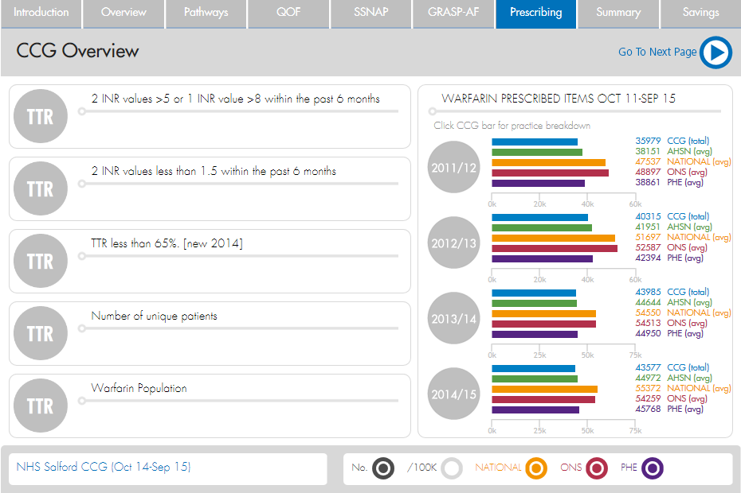
TTR and ePACT

Slide 10
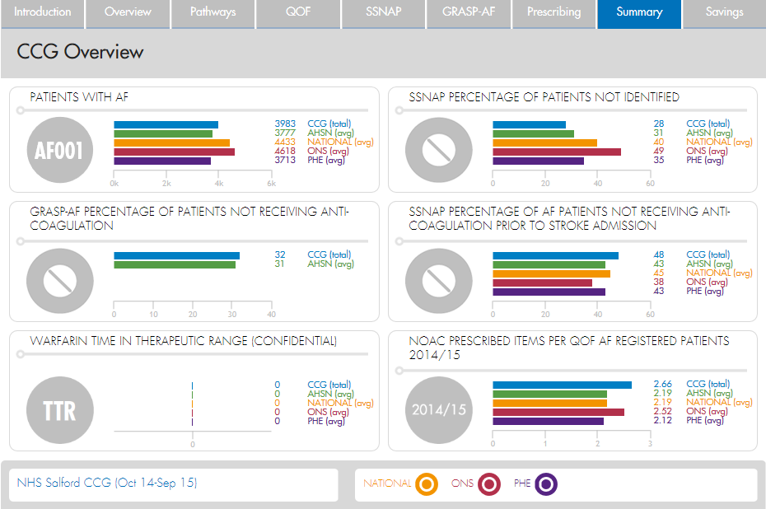
Summary

Slide 11
Uptake of the data tool
Manchester AHSN
North West Coast AHSN
Partner with Public Health England on a national AF dashboard
Creating the national AHSN ‘measure of success’ AF dashboard
Notes:
Start with the simple questions… and we still don’t know
Calculation = QOF register of chads2 being treated – NOAC = warfarin?

Slide 12
Next steps
A more informative data tool
Moving beyond the presentation of data
Working with East Kent Beautiful Information to add a layer of analytics
Gaining new insight and working with new national experts
David Hargroves
Jane Molloy
Jane Macdonald

Slide 13
Further information
jane.macdonald@gmahsn.org
Director of Implementation
andi.orlowski@gmahsn.org
Associate Director for Health and Implementation

